Slide 1

In-depth Analysis of Multi-Agent Path Finding Algorithms
By Brett Bala & Kirt Narain

Slide 2
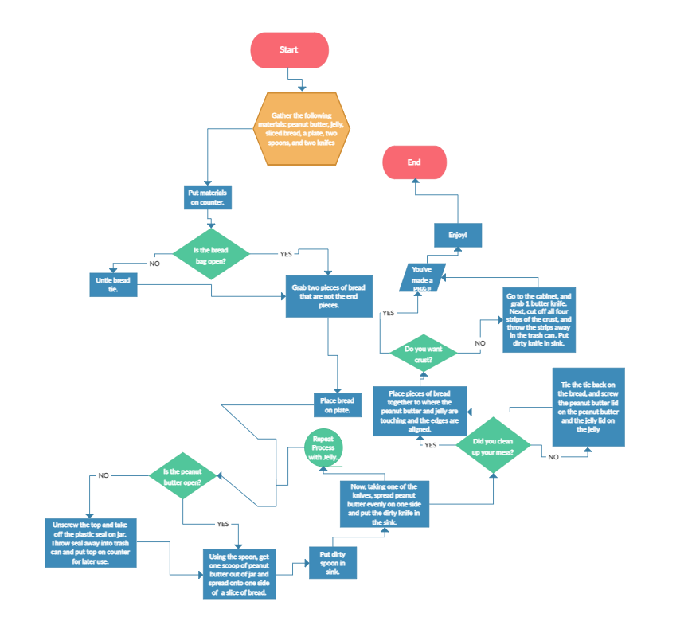
Kirt Narain CS Major
Favorite Algorithm: PB&J Instructions
Favorite Class: CS 477
Fun Fact: Kirt’s favorite letter is O (because it is big O not little o)
Notes:
Kirt

Slide 3
Brett Bala CS Major
Favorite Algorithm: Sleepsort
Favorite Class: CS 477
Fun Fact: My favorite letter is Y. Why? Because it does what it wants. Sometimes it's a consonant, sometimes a vowel, that's why.

Slide 4
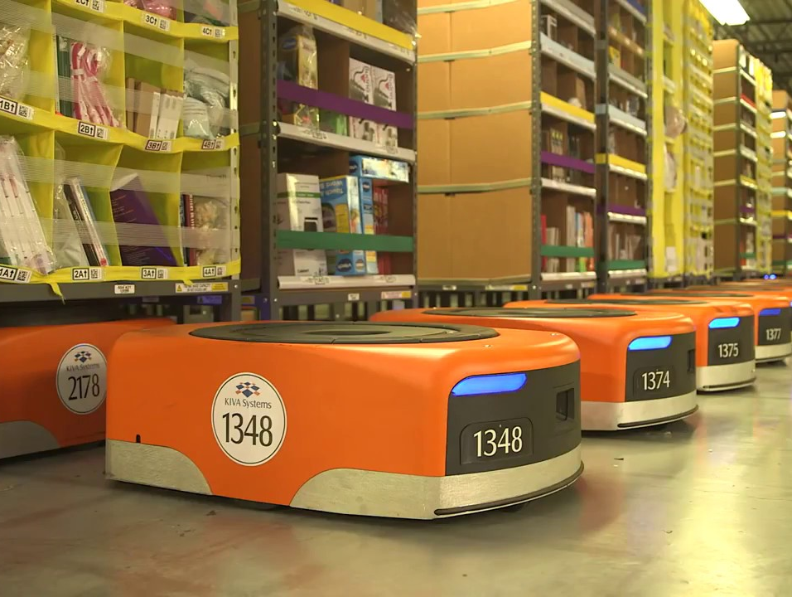
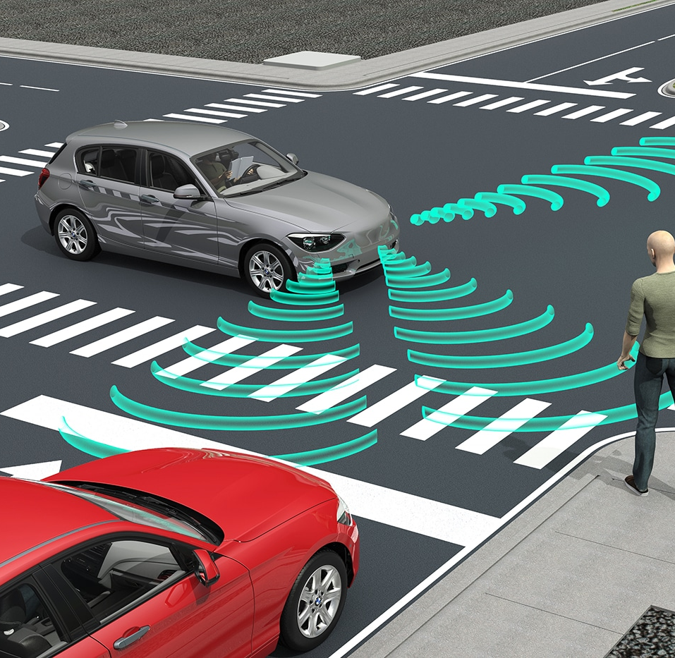
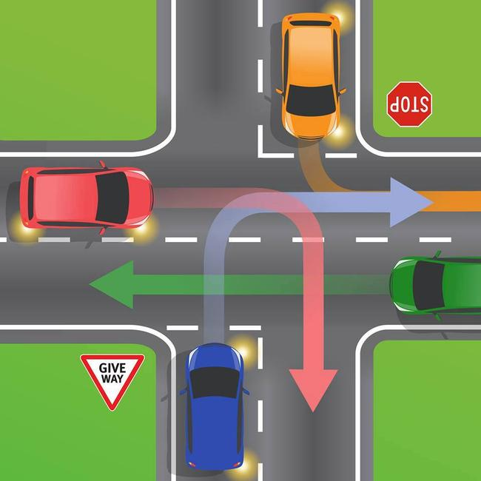
Recent Surge Of Multi-Agent Path Finding (MAPF)
MAPFs have started to gain more popularity in recent years due to application to drone technology (like Amazon Warehouse drones) and autonomous vehicles.
However, MAPFs have been utilized for another real-world projects, such as organizing traffic intersections and plane taxing.
Notes:
Brett

Slide 5
How MAPF Works
Given: n number of agents, each having a start and goal location in a known environment (not an unknown area)
Objective: Find collision-free path for each agent to get from their start to their goal location
There may be extra parameters/conflicts like swapping instead of moving, we will discuss these later
You can aim to minimize a certain element such as:
Least Distance Moved: Minimize the total number moved (either globally or locally for a given agent)
Least Time Spent: Minimize the total time spent to get to goal (either globally or locally for a given agent)
Notes:
Brett
http://idm-lab.org/slides/mapf-tutorial.pdf slide #1

Slide 6
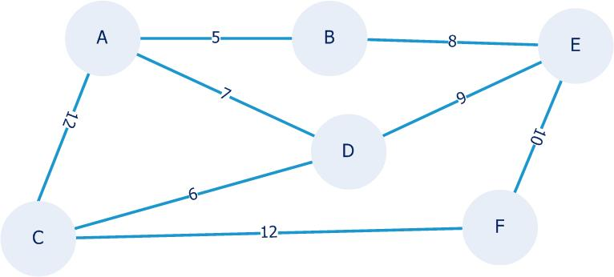
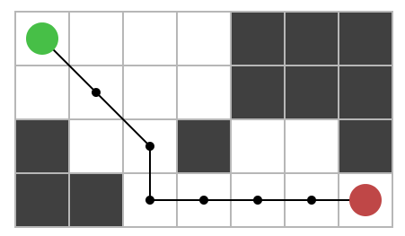
Previous Pathfinding Algorithms
Algorithms like Dijkstra's and A* usually work under the assumption of finding a path to one target location for one agent. They are widely used today and well known but are not built for having multiple agents traversing the same map.
Notes:
Brett

Slide 7
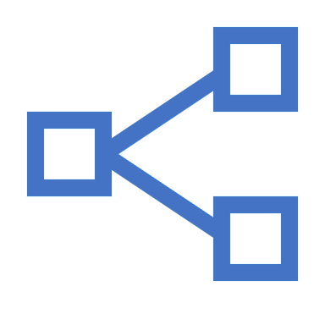
Introducing Multiple Agents and Goals
Notes:
Kirt

Slide 8
Different Abstract Actions of MAPF
In each MAPF circumstance, certain actions exist for the given scenario such as:
Swapping
Wait Time
Goal Departure
Notes:
Kirt
https://icaps20.icaps-conference.org/paper319.html

Slide 9


Abstract Actions: Swapping
If there is swapping, agents can swap locations, meaning there is no edge conflicts (we will discuss this later). There are 3 ways swapping is addressed:
There is no swapping allowed (There can be edge/swapping conflicts).
There is swapping allowed, but regular movement is allowed (No edge/swapping conflicts).
Only swapping is allowed (No edge/swapping conflicts or regular movement).
Agent 1
Agent 2
Node A
Node B
Swapping Allowed:
Swapping Disallowed:
Notes:
Kirt

Slide 10
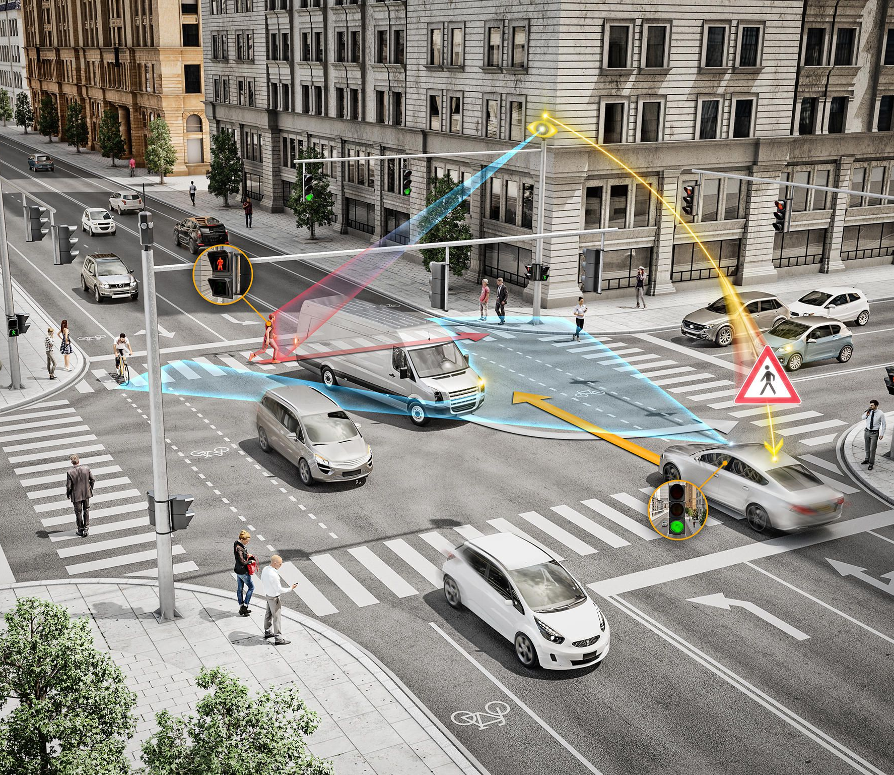
Abstract Actions: Wait Time
Wait Time describes how long actions take. Perhaps a given movement takes 2 units of time or a unit of 1 second between movements. Wait Times change depending on the given scenario.
For example, a given drone may take 1 unit of time to move 1 unit of space.
Meanwhile, a stop light might prove a given vehicle waits 10 units of time.
Notes:
Kirt

Slide 11
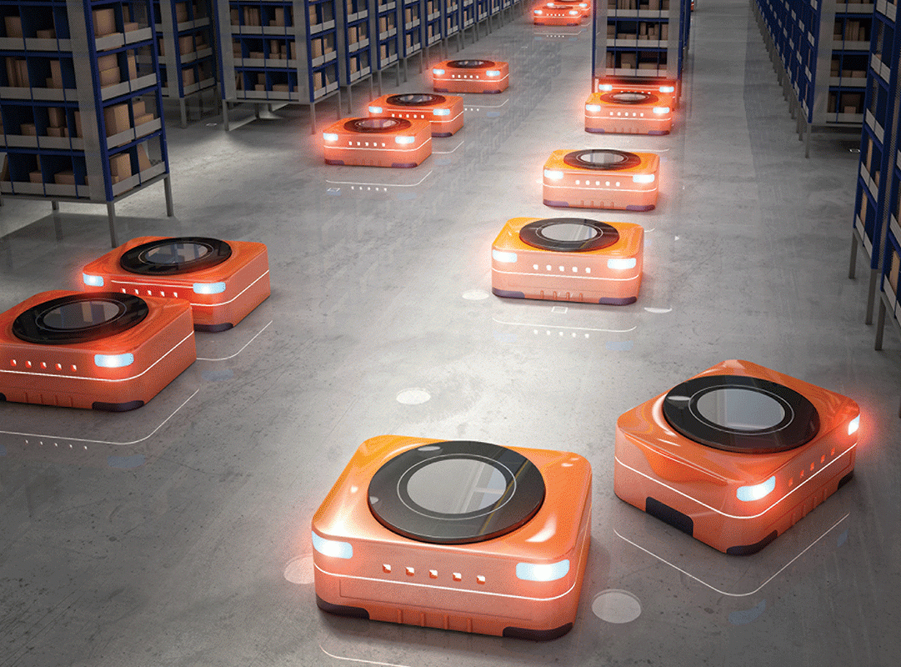
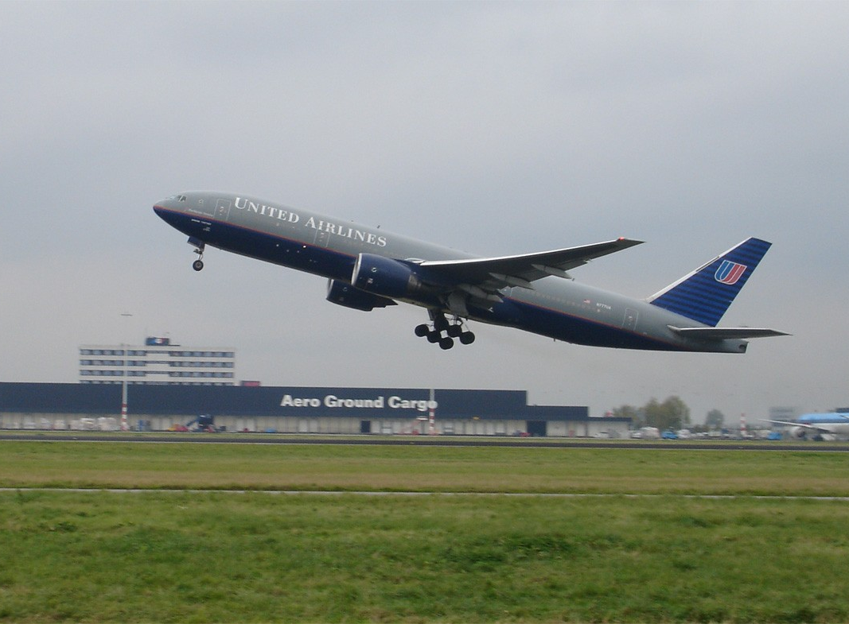
Abstract Actions: Goal Departure
Goal Departure describes what happens to the agent once it reaches its destinations. Typically, one of two things occur:
When an agent arrives to its goal, it is still active in the MAPF problem/interacts with other agents
Think a robot moving around an Amazon Warehouse, it is still part of the environment once it reaches its goal.
When an agent arrives to its goal, it is no longer active in the MAPF problem/no longer interacts with other agents (it essentially “disappears”)
Think an airport runway organizing departing planes. Once a plane leaves, for the airport it is essentially gone from the problem.
Notes:
Kirt

Slide 12
Different Restrictions of MAPF
There are several different conflicts that two or more agents can cause:
Vertex
Edge/Swapping
Following
Cycle
Notes:
Brett

Slide 13
Restrictions: Vertex Collision
Agent 1 moves from X to Y
Agent 2 moves from Z to Y
The Agents cannot occupy the same vertex at the same time
Agent 1
Agent 2
Node X
Node Y
Node Z
Notes:
Brett

Slide 14
Restrictions: Edge/Swapping Conflict
Agent 1 wants to reach Node Y
Agent 2 wants to reach Node Z
The path to Node Y and Node Z overlaps
Node Z
Agent 1
Node W
Node Y
Agent 2
Node X
Notes:
Brett

Slide 15
Restrictions: Following Conflict
Agent 1 wants to occupy a node where Agent 2 occupied in the previous step
Agent 2 is still occupying the node when Agent 1 tries to move
Agent 1
Agent 2
Node X
Node Y
Node Z
Notes:
Brett

Slide 16
Restrictions: Cycle Conflict
In the same time step, every agent wants to move to a vertex that was previously occupied, making a rotating cycle, or if there is only one possible move for each agent to make
Agent 1
Agent 2
Agent 3
Notes:
Brett

Slide 17
Evaluations of MAPF
Makespan: The number steps (or 'turns'), required for all agents to reach their target.
Sum of costs: The summation of each agent's makespan. Also known as 'flowtime'.
Notes:
Brett

Slide 18
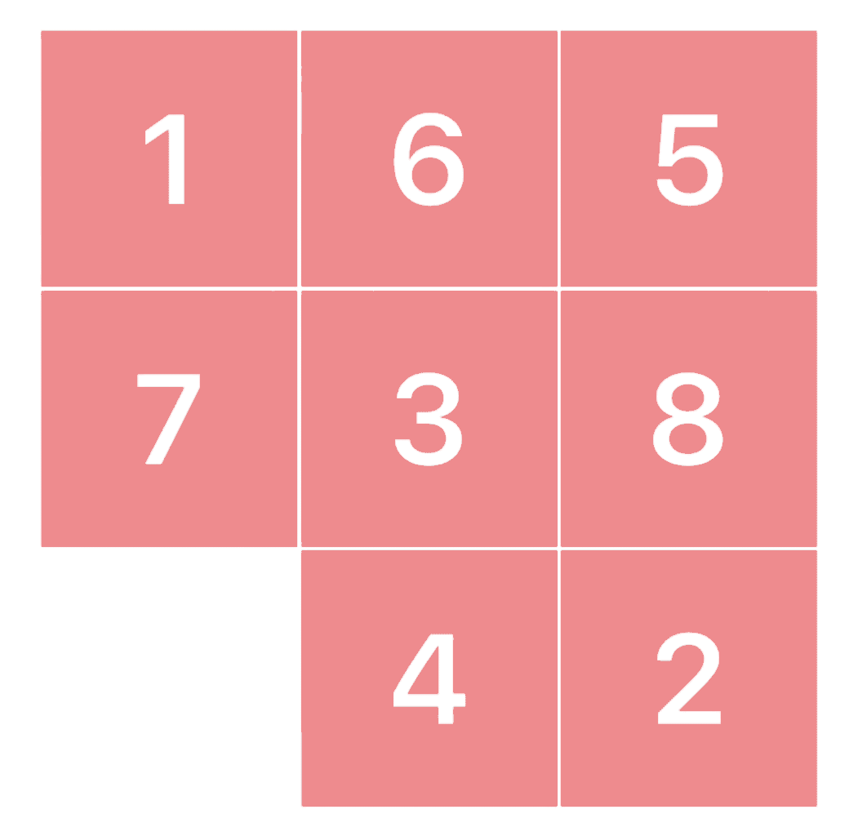
Our Implementation
Notes:
Kirt

Slide 19

Sliding Puzzle Solver
We plan to implement a sliding block solver utilizing MAPF principles/Divide and Conquer.
We will generate random sliding puzzles for it to solve.
Language used will either be Java or Python
Notes:
Kirt

Slide 20

But what is MAPF about a sliding puzzle?
Notes:
Kirt

Slide 21
MAPF Basics Regarding Sliding Puzzles
The sliding puzzle meet the basic criteria of MAPFs with the following:
All tiles (agents) can move.
Though one at a time otherwise they would cause vertex/edge conflicts.
Each tile has a known starting and goal position.
The environment (board) is known.
The puzzle is complete once every agent reaches its goal position
Notes:
Kirt

Slide 22
Abstract Actions for Sliding Puzzles
Sliding Puzzles stay at their goal position once they reach it, they do not disappear from the problem (they can still be moved).
Just like the Amazon robots, and the opposite of departing airplanes.
Sliding Puzzles do not swap what-so-ever, so they may only move to an open space (there is only one in this case)
Notes:
Kirt

Slide 23


Any Questions?
Notes:
Kirt/Brett

Slide 24
References
R. Stern, N. Sturtevant, A. Felner, S. Koenig, H. Ma, T. Walker, J. Li, D. Atzmon, L. Cohen, T. K. S. Kumar, E. Boyarski, and R. Bartak, “Multi-Agent Pathfinding: Definitions, Variants, and Benchmarks,” arXiv.org, 19-Jun-2019. [Online]. Available: https://arxiv.org/abs/1906.08291. [Accessed: 02-Apr-2021].
N. Ayanian, T. Cai, and L. Cohen, “Multi-Agent Path Finding,” idm-lab. [Online]. Available: http://idm-lab.org/slides/mapf-tutorial.pdf. [Accessed: 02-Apr-2021].

